Slide 1
Common Windows Tools
Anika Karpurapu

Slide 2
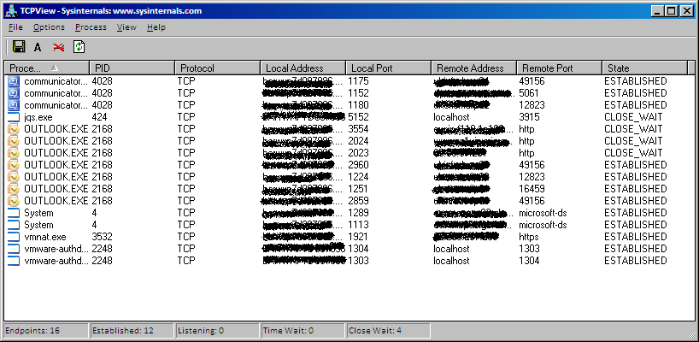
TCPView/TCPvcon
TCPView - GUI interface
TCPvcon - Command Line
tcpvcon [-a] [-c] [-n] [process name or PID]
-a: Show all endpoints (default is to show established TCP connections).
-c: Print output as CSV
-n: Don't resolve addresses.
Shows Ports
Download link

Slide 3
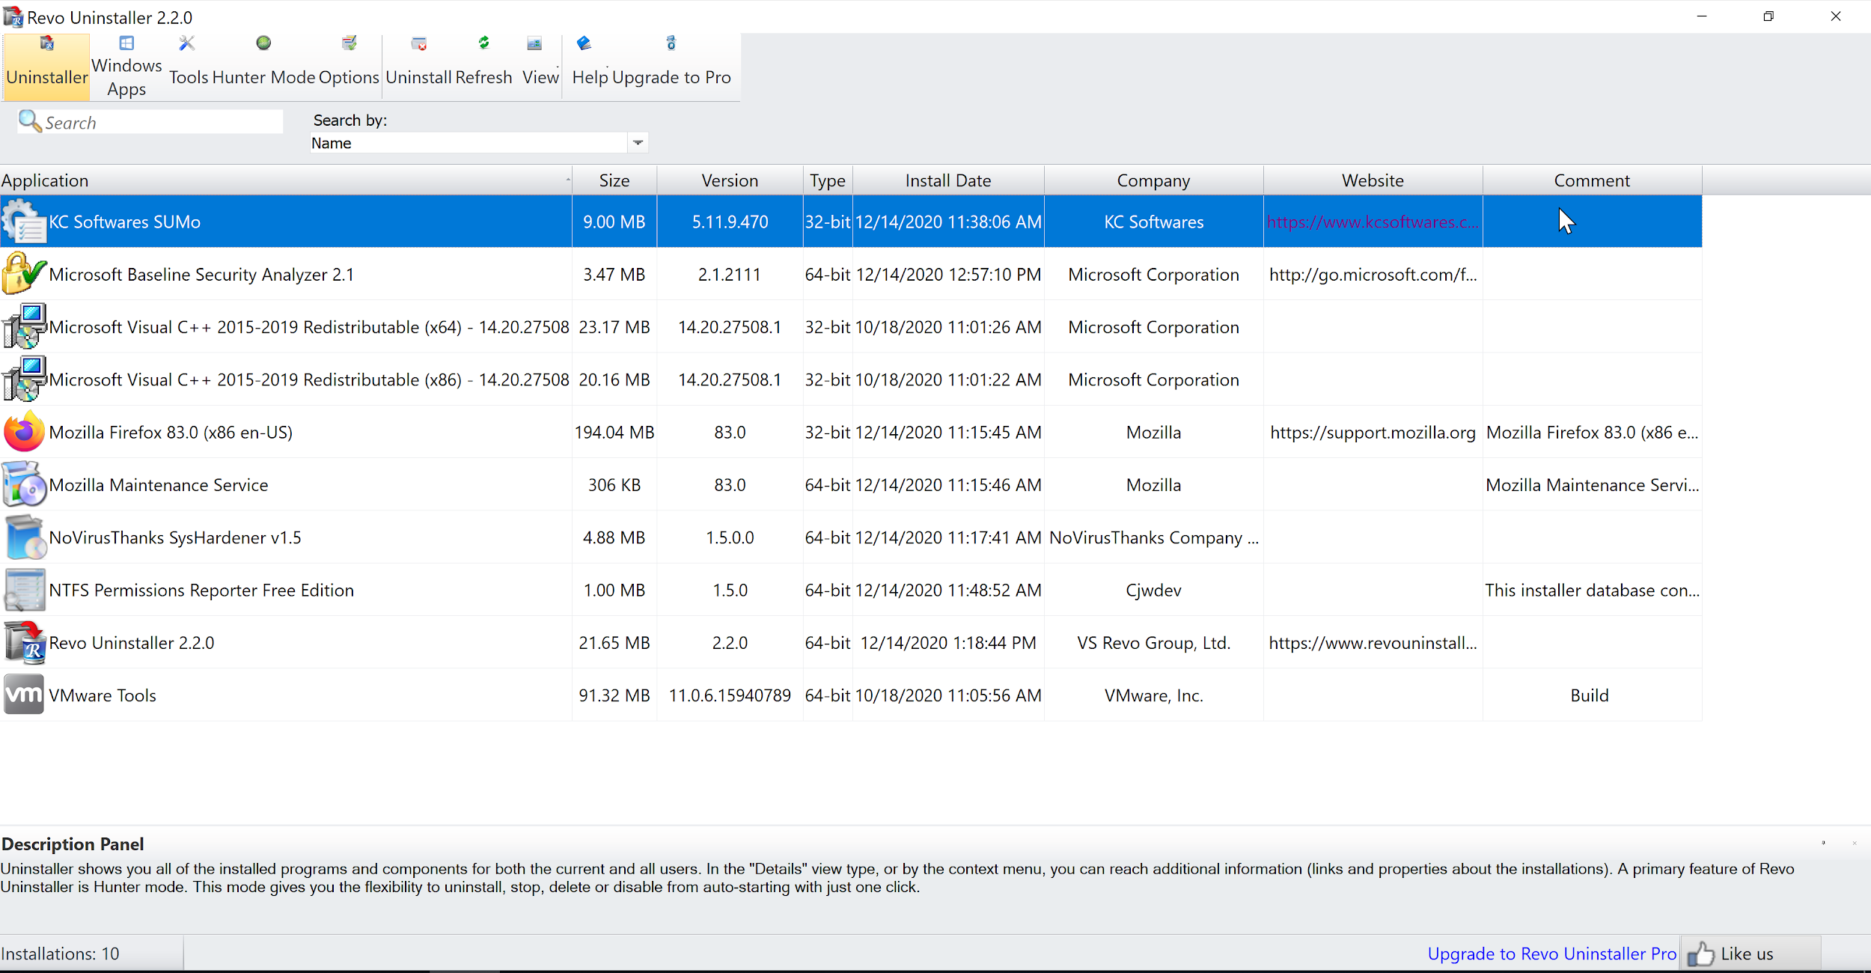
Revo Uninstaller
Quick way to uninstall unnecessary programs
Download link

Slide 4
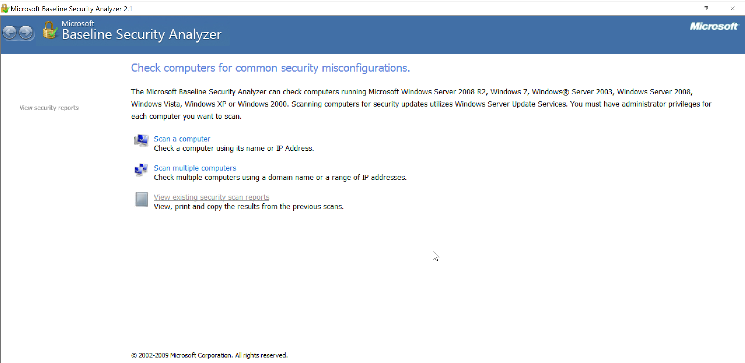
Microsoft Baseline Security Analyzer (MBSA)
Download link
Scan a computer → Start Scan (leave all options as defaults)

Slide 5
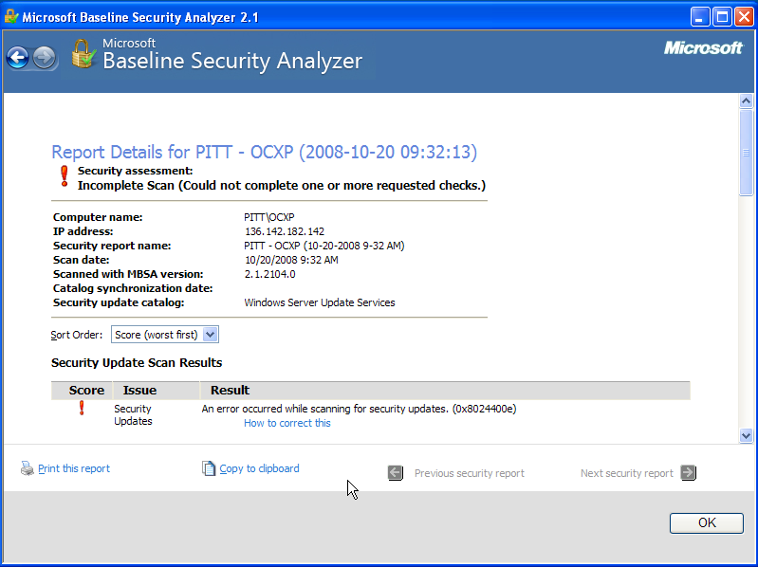
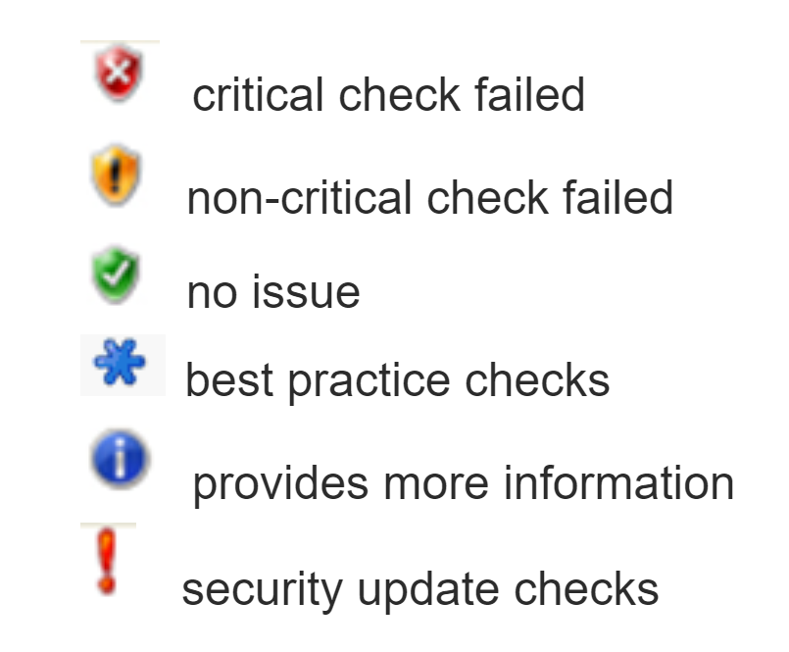
MBSA

Slide 6
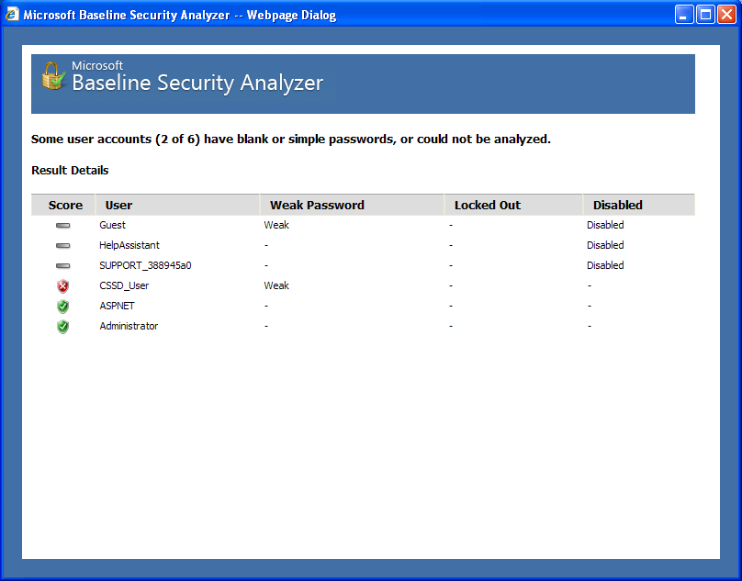
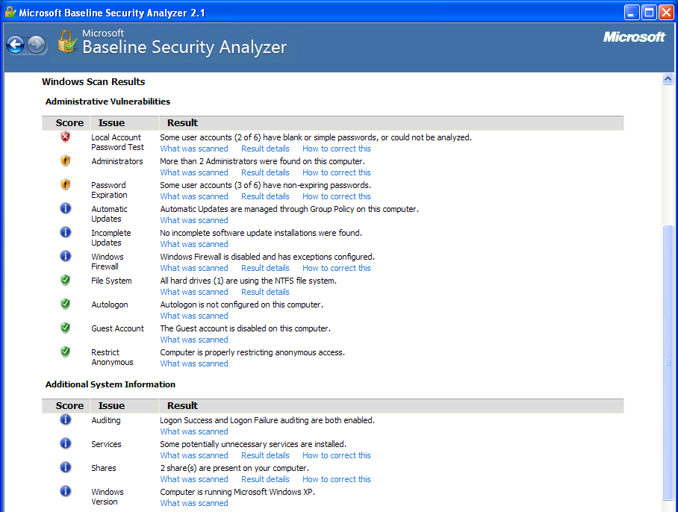
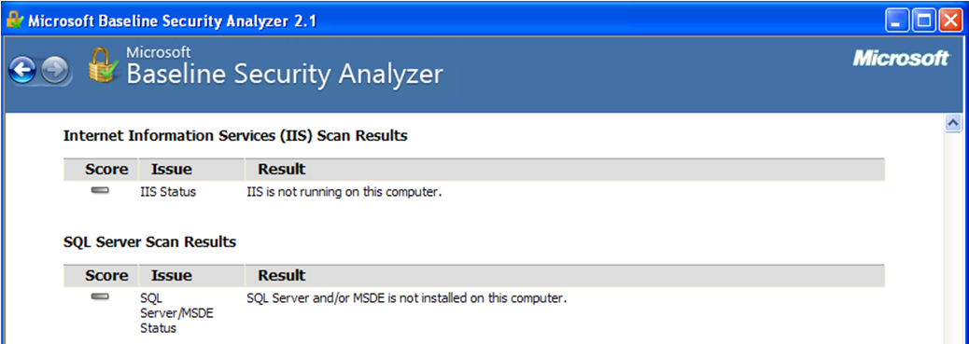
MBSA

Slide 7
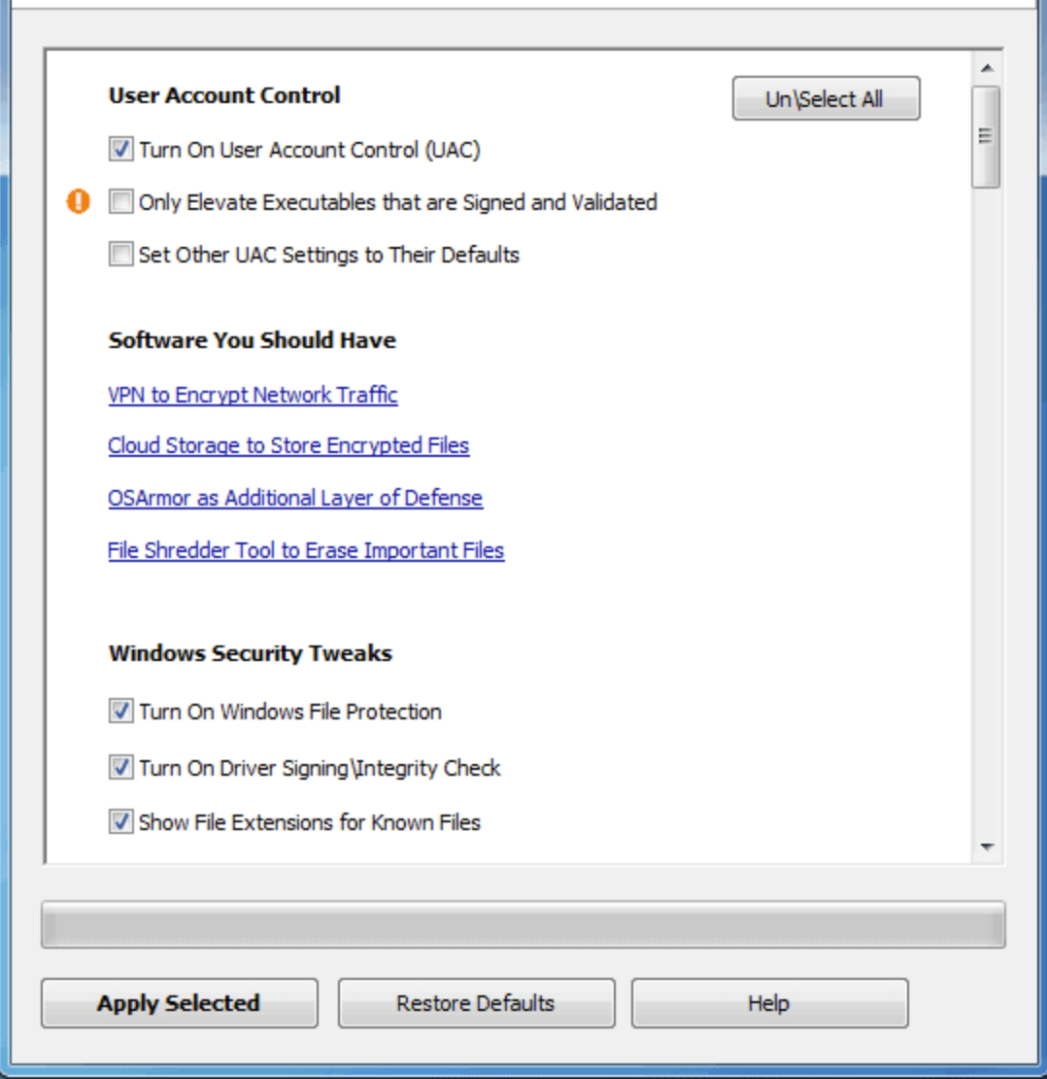
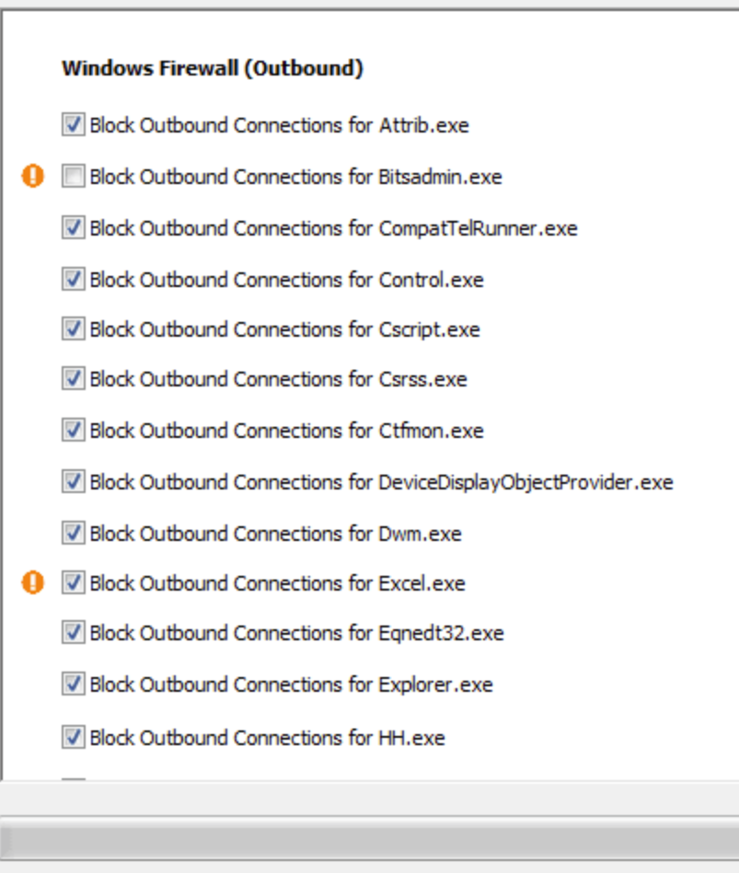
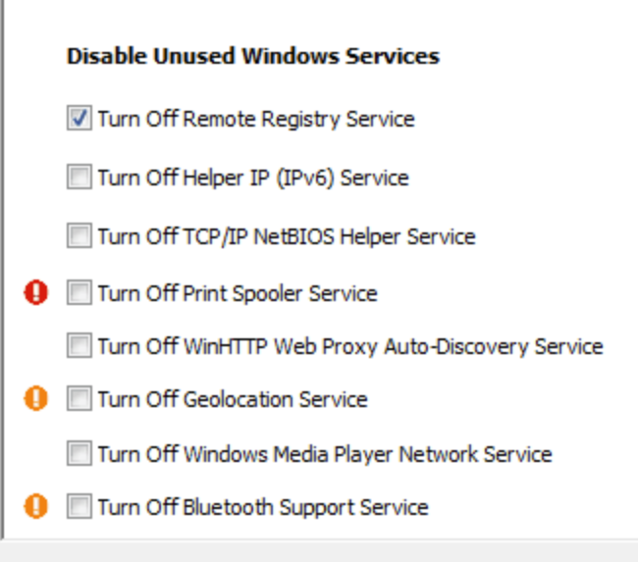
SysHardener1.5
Helps to harden Windows OS
Disables functionalities not required; firewall rules
Command line: /applyselected or /restoreselected
Download link

Slide 8
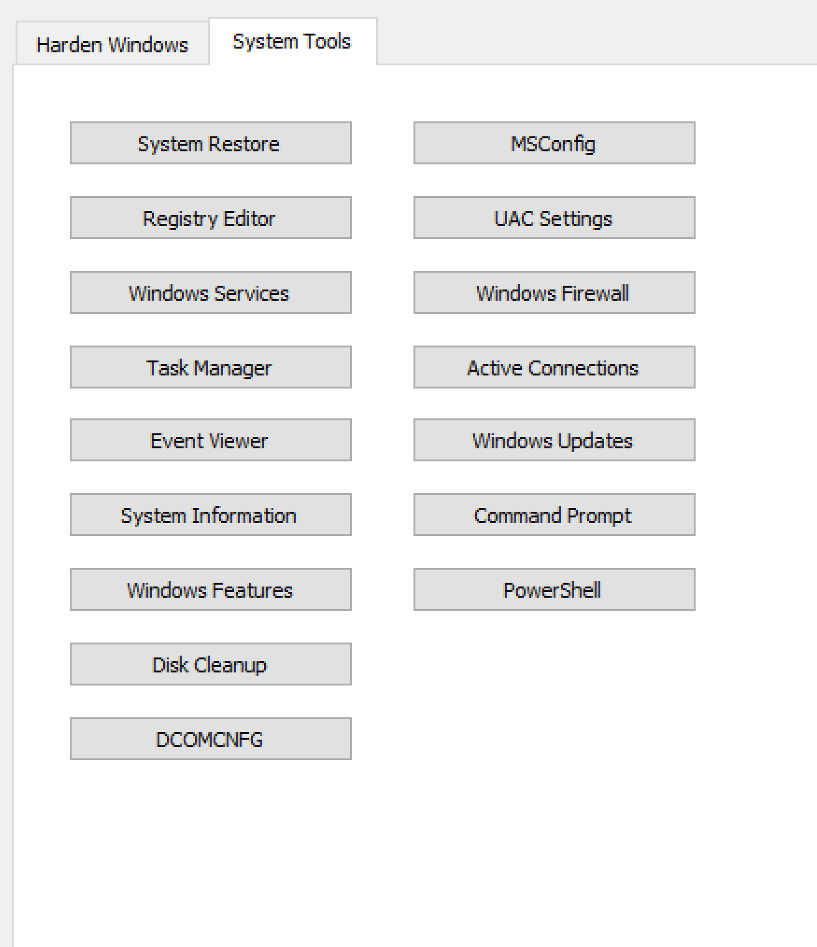
SysHardener1.5
Provides easy access to commonly used system tools

Slide 9
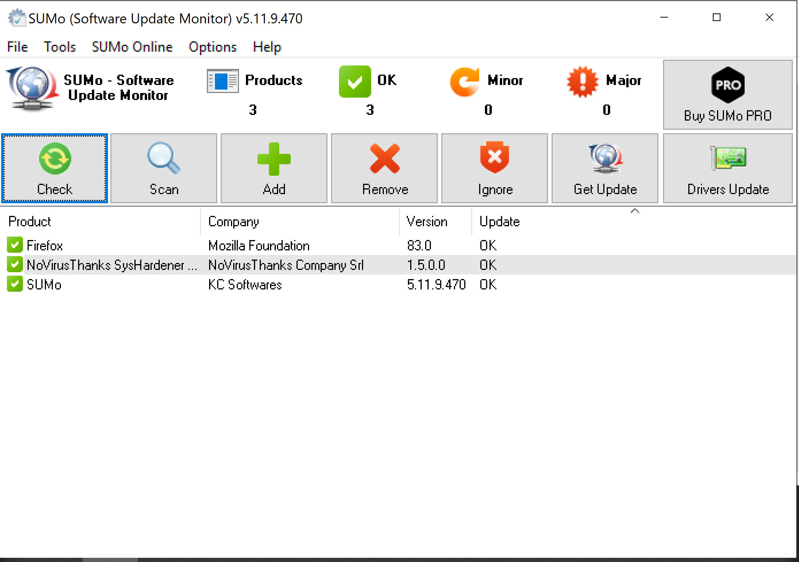
SUMo
Automatic updates tool
Download link

Slide 10
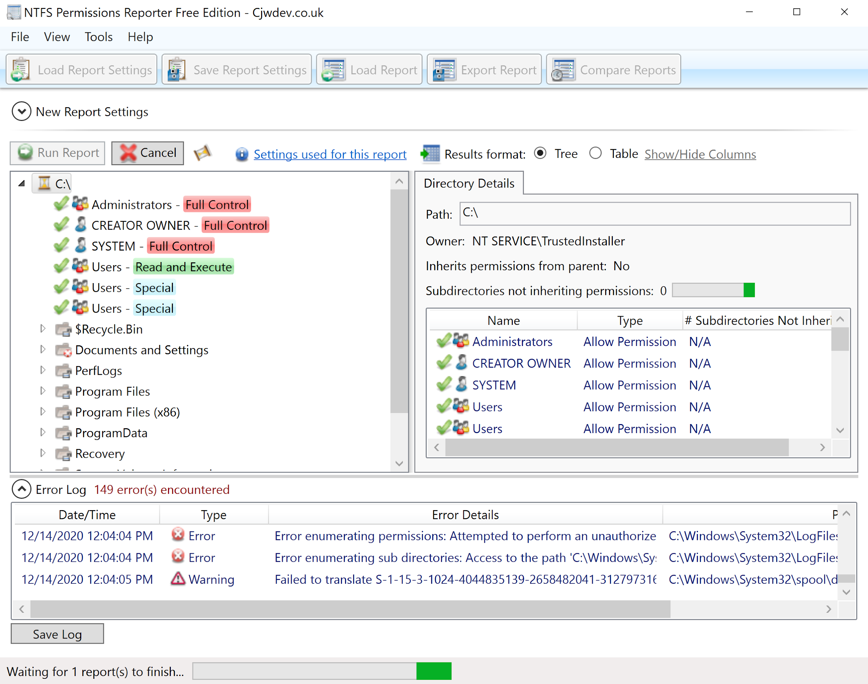
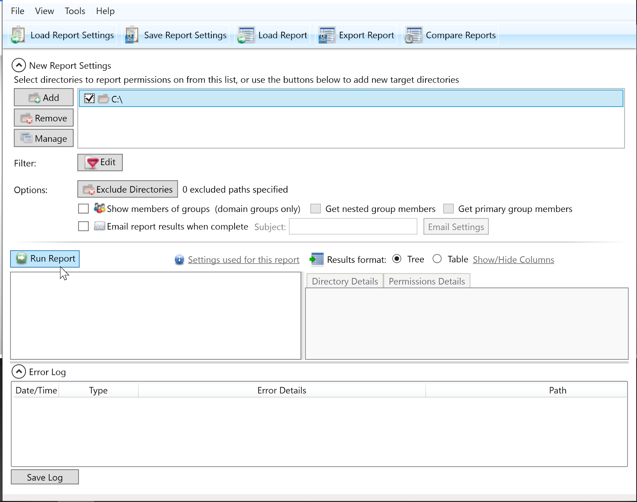
CJWDev
File permissions reporter - reports on directory permissions
NTFS - storing, organizing, and finding files on a hard disk efficiently
Click on a directory → run report
Download link

